Slide 1
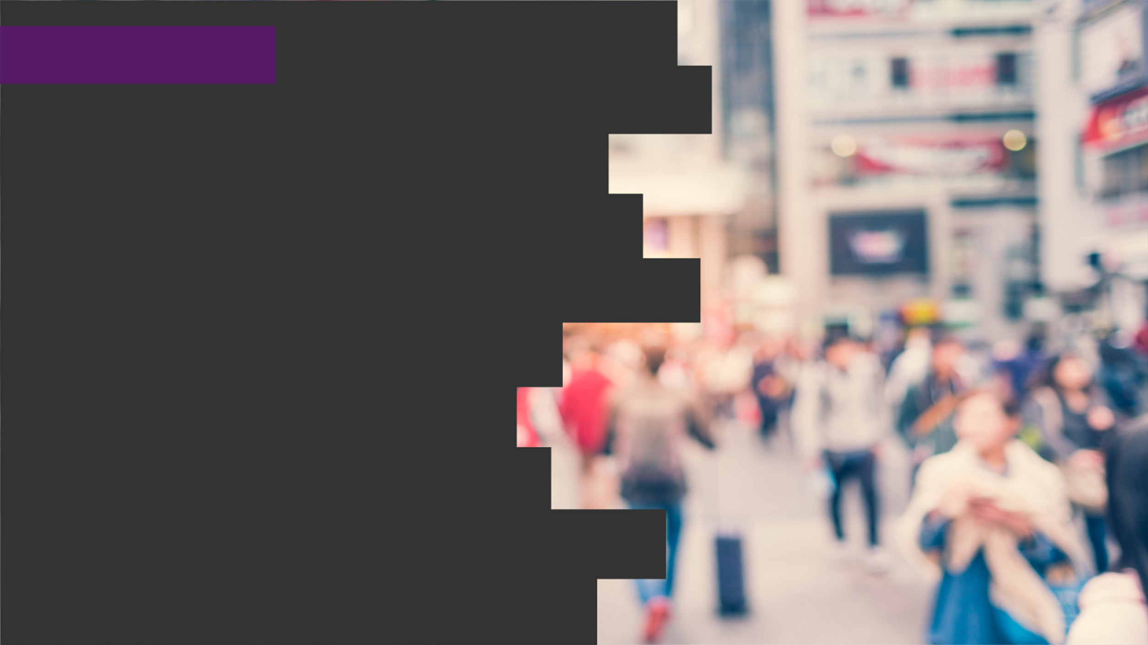

2020
Netcoreconf
Azure Durable Functions: Detrás de la magia
Juan Carlos Martinez
Luis Mañez
18/01/2020
Technical architect “Mr. Connect” (ClearPeople LTD)
Cloud Solutions Architect (ClearPeople LTD)
@jcmartinezg23
@luismanez

Slide 2
Sponsors

Slide 3
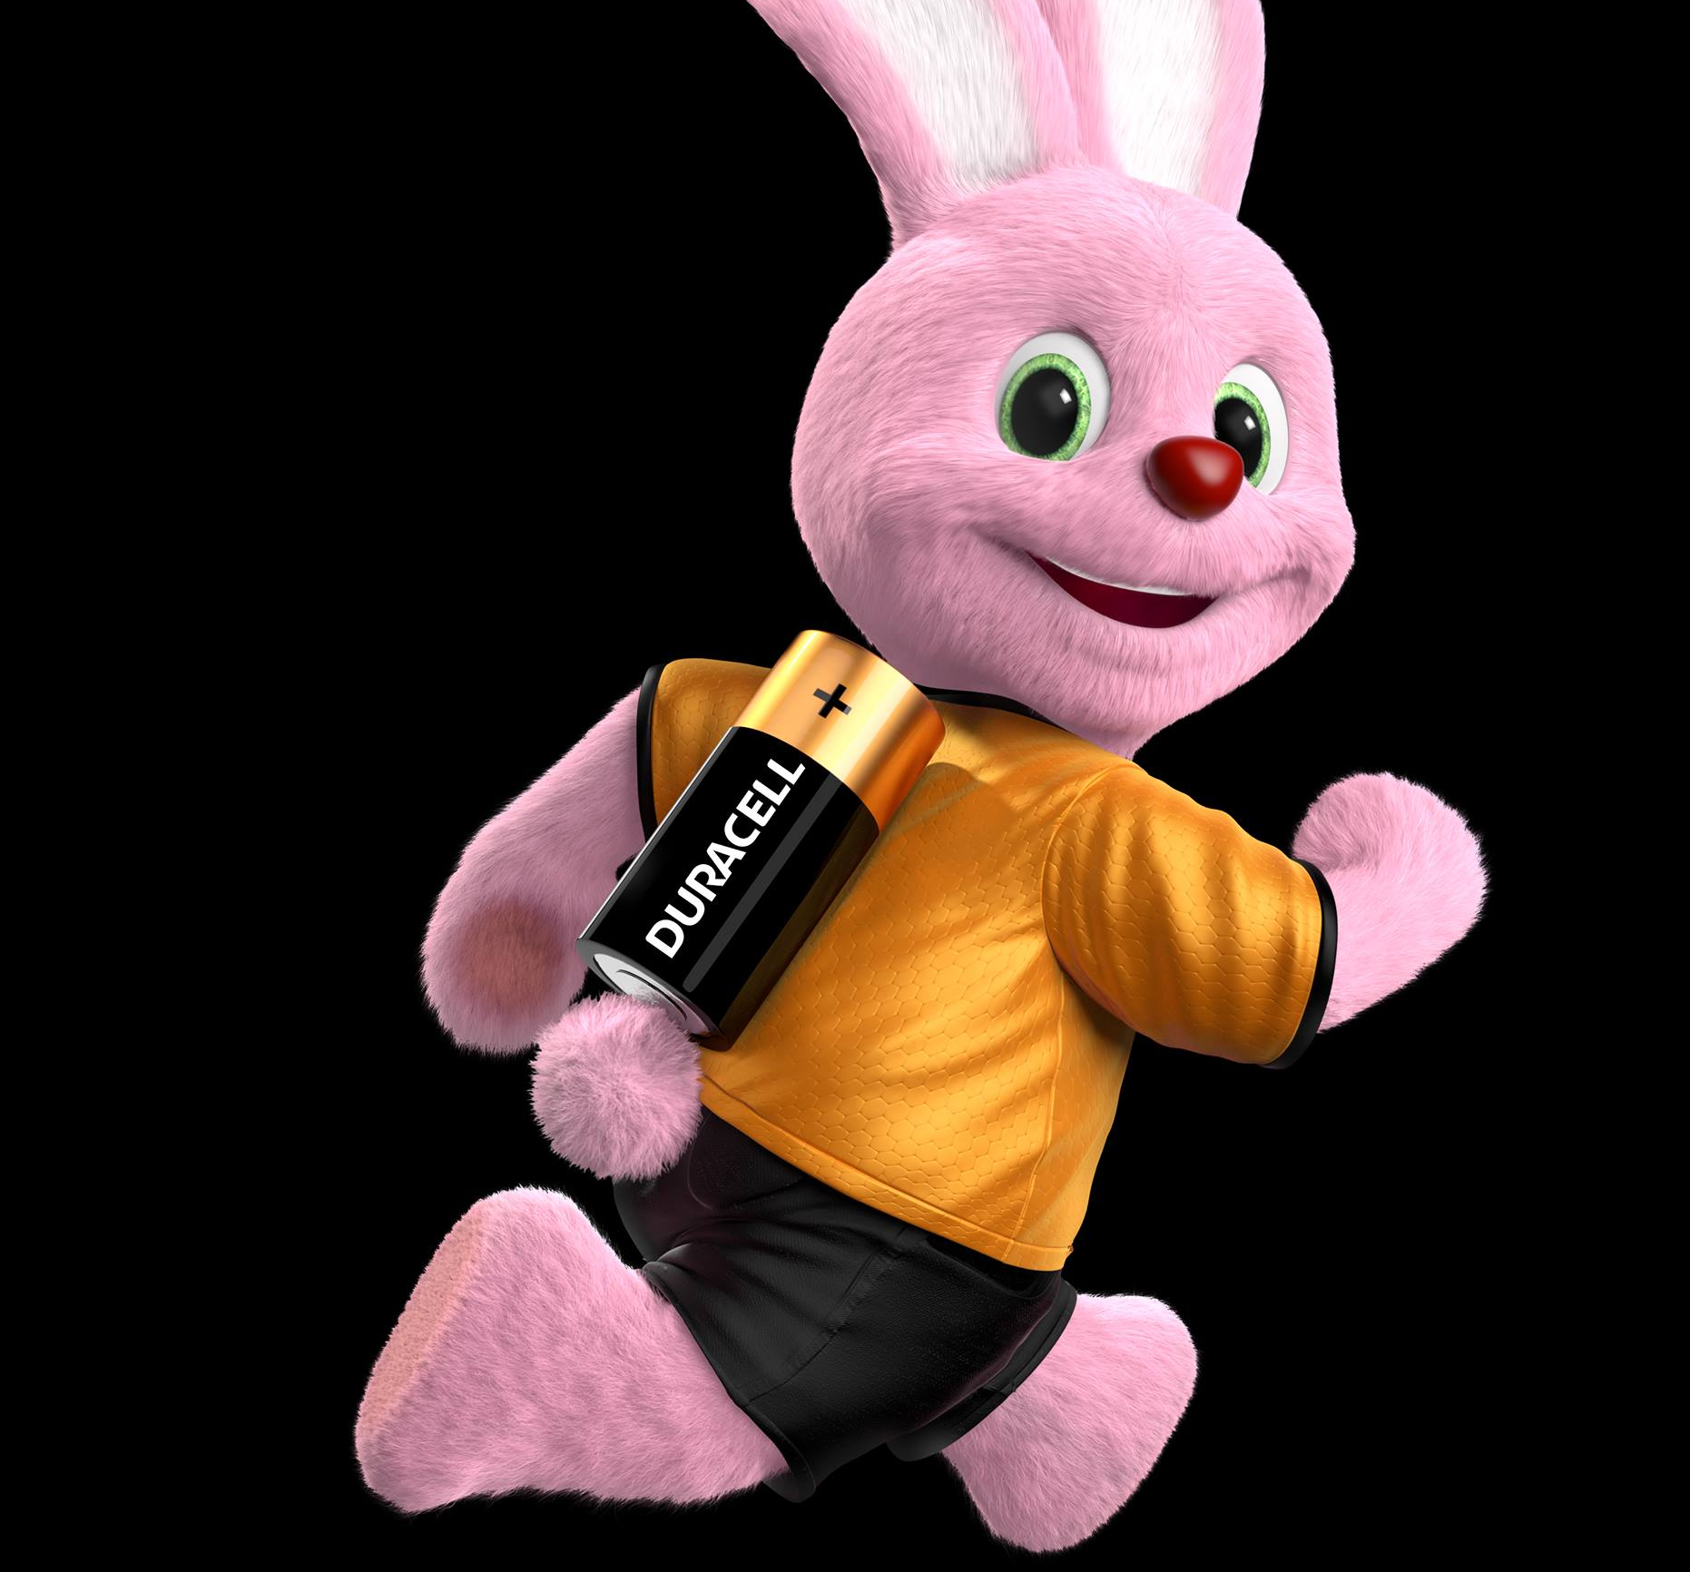
What are
“Azure Durable Functions”?

Slide 4
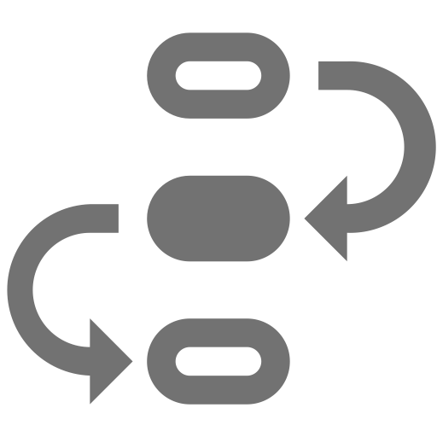


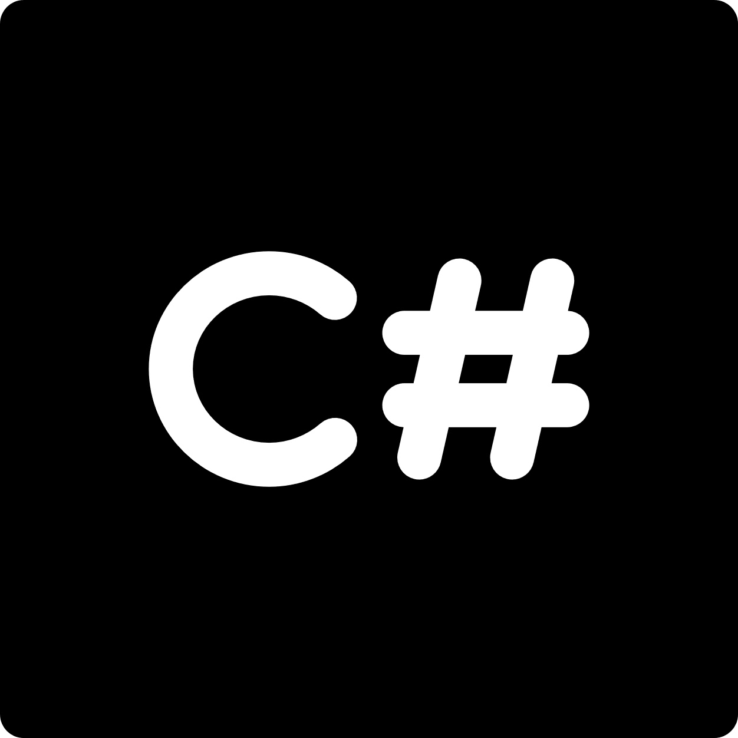

stateful functions in
serverless environment
workflow in code
azure functions extension
languages
F#

Slide 5
Event Sourcing

Slide 6
What it is Event Sourcing
Design pattern that specifies a way of storing app state
This app state is composed by a conjunction of events
EVERY change on the state is stored sequentially
Allows us to recreate or query app state at any given time

Slide 7
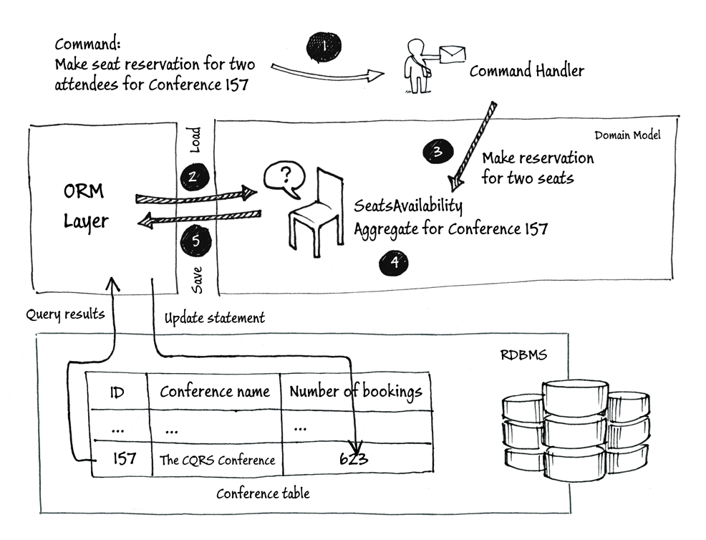
ORM Approach

Slide 8
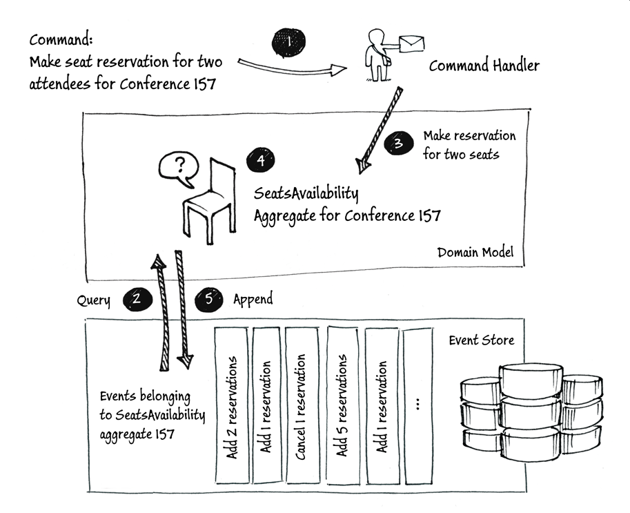
Event Sourcing Approach

Slide 9
How it works within Durable Functions
Azure Storage tables act as the storage system
One row per status change
Columns to store inputs, outputs and additional details
Framework uses the events stored in the table to rebuild the orchestrator state

Slide 10
Durable Functions Application Patterns

Slide 11
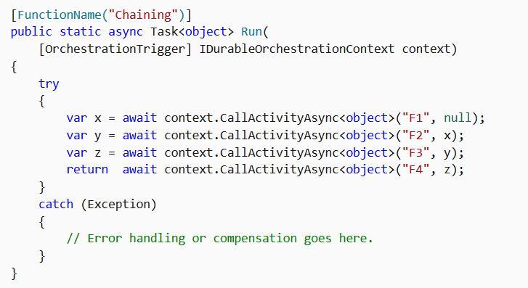
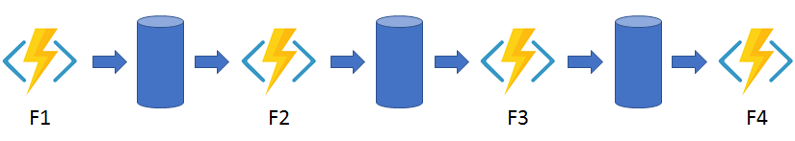
Function chaining

Slide 12
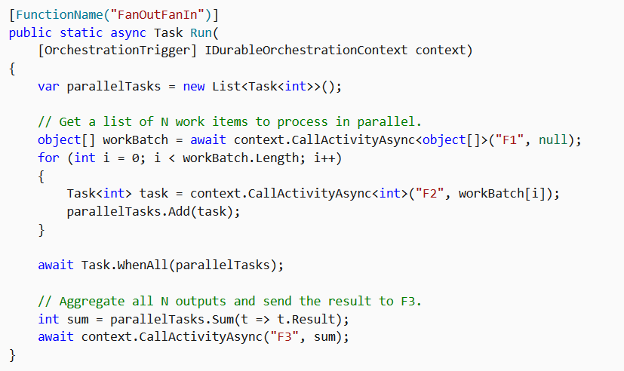
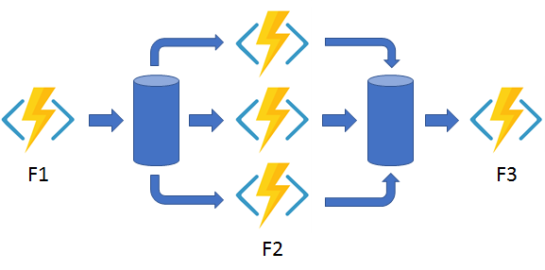
Fan out/fan in

Slide 13
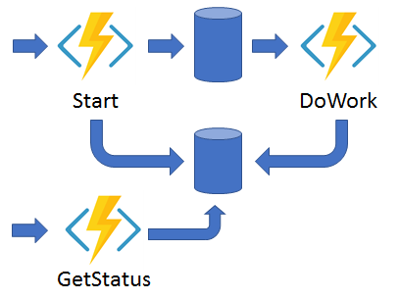
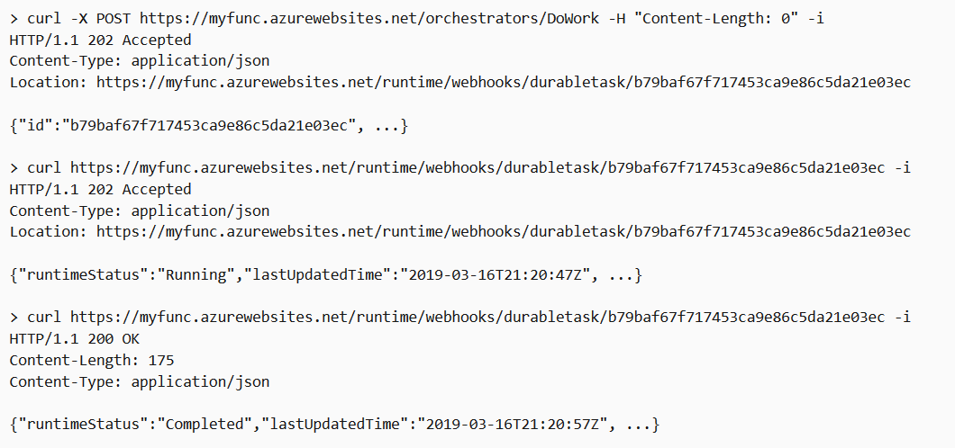
Async HTTP APIs

Slide 14
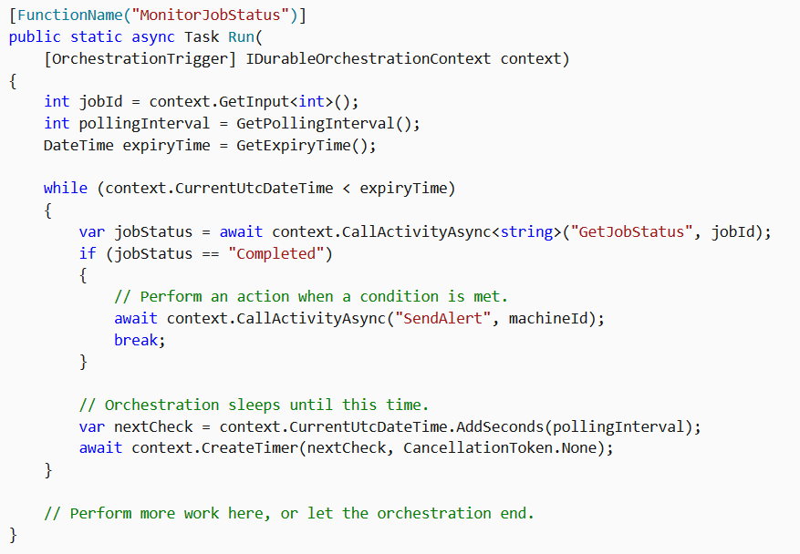
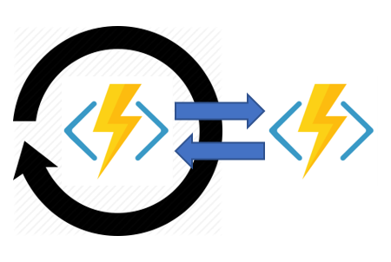
Monitor

Slide 15
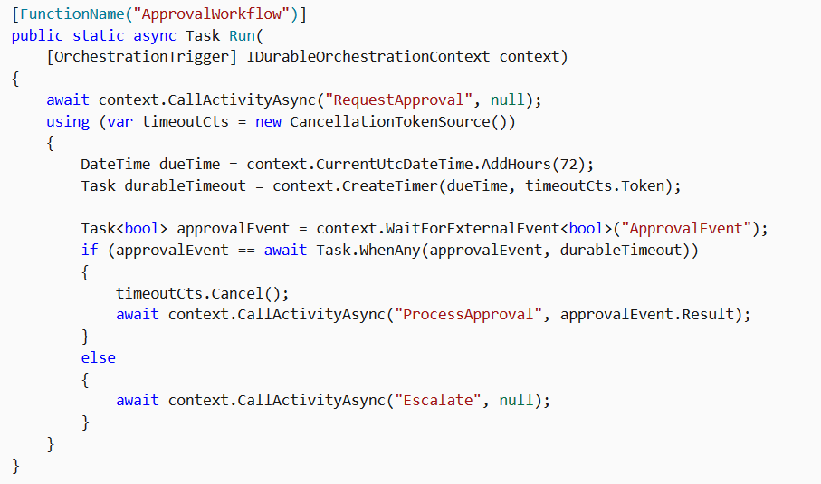
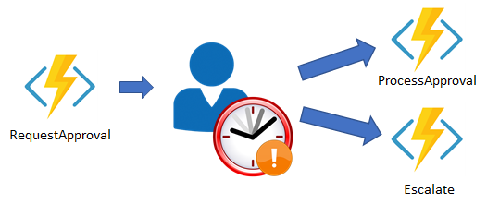
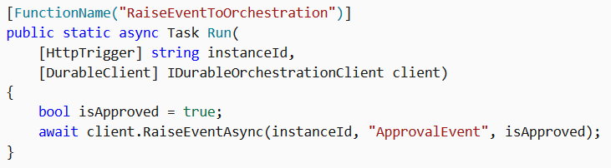
Human interaction
curl -d "true" http://localhost:7071/runtime/webhooks/durabletask/instances/{instanceId}/raiseEvent/ApprovalEvent -H "Content-Type: application/json"

Slide 16
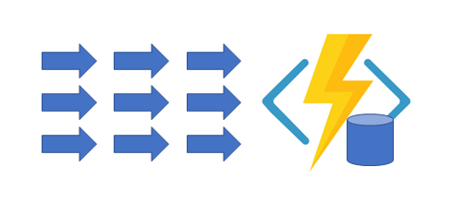
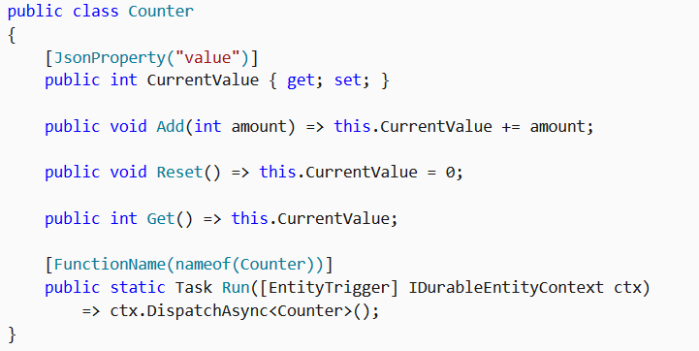
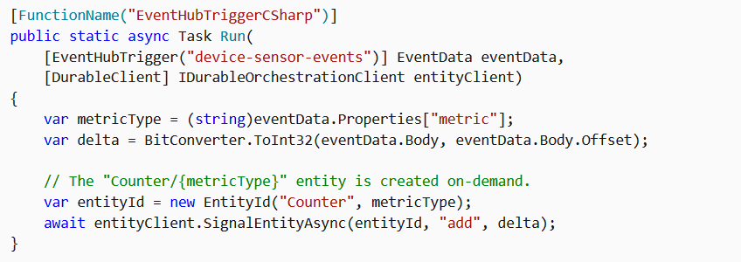
Aggregator

Slide 17
Orchestrator function code constraints

Slide 18
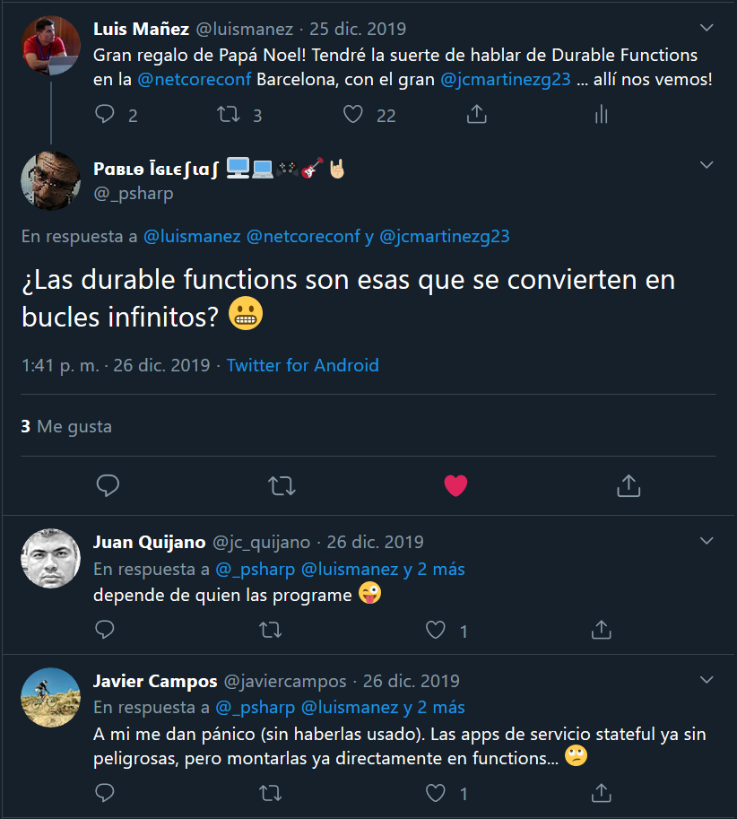

Slide 19
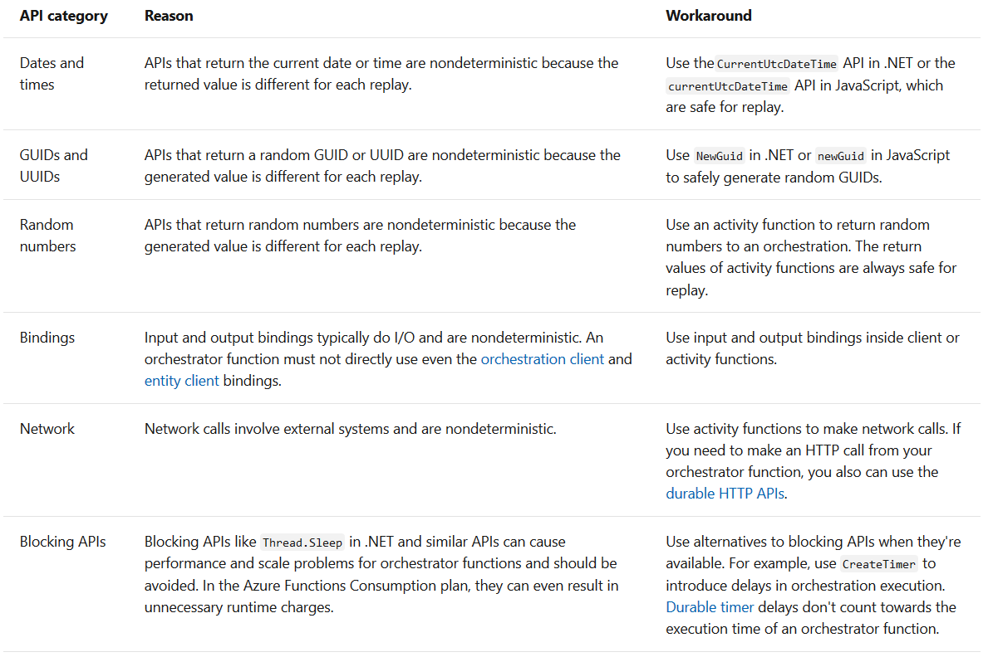
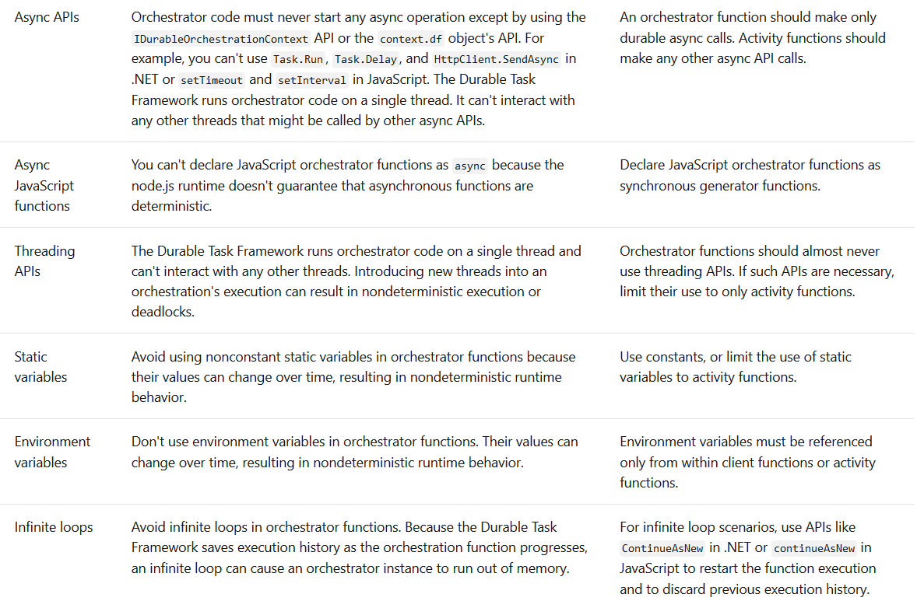
https://docs.microsoft.com/en-us/azure/azure-functions/durable/durable-functions-code-constraints

Slide 20
That´s cool… Can you show me some code?

Slide 21


Instanyam!
Making #foodielovers since 2020

Slide 22
https://github.com/luismanez/netcoreconf-bcn-2020

Slide 23
Sponsors

Slide 24
Más información:
info@netcoreconf.com
@Netcoreconf
Visítanos en:
netcoreconf.com
GRACIAS

